Slide 1
CBSO Webservices Demo
CBSO Support Team

Slide 2
Agenda
Concepts
Description of webservices offer
Getting access to the webservices
Overview of data
Performing actions on the webservices
Some internals
Transition
Welcome

Slide 3
Concepts

Slide 4
Webservice, short def. :
“Operation between Machine A and Machine B”

Slide 5
Concepts
Webservice commercial offer is organized into products
An abonnee subscribes to one or more products (free or paid)
Webservice technical access “is organized” into APIs
A technical user executes one ore more operations of an API via a software
A product or an API is a group of operations that can be performed on data
In current setup : 1 product is mapped to 1 API

Slide 6
Concepts
Operation 1
Operation 2
Product A
API A
Subscription
Operation 3
API B
Abonnee
Operation 4
Software
Product B
Technical user
Operation 5
Product C

Slide 7
Description of Webservices offer

Slide 8
Overview webservices offer
Product | API | Content
Authentic-Query | /authentic | Query and obtain data of published deposits (not “touched” by NBB) → One by one
Authentic-Extract | /extract | Download data packages of published deposits → A zip file
Improved | /improved | Query and obtain data & Download data packages improved by NBB (PDF encoded, converted to EURO, corrections by NBB)

Slide 9
Product – Authentic Query
Goal : Give access to all deposits published by the NBB (except some with derogation, idd Consult)
Usage : Retrieve data for a legal entity
Available data :
All references of deposits since 1978 (JSON)
All images of deposits since 1999 (PDF) (PDF produced by NBB if XBRL deposit, original PDF if PDF deposit)
All XBRL of deposits since 2007 (XBRL) (only if the referenced deposit was originally an XBRL)
All extracted data of deposits since 2022 (JSON) (only if the referenced deposit was originally an XBRL)
Retrieval mode is « Query based » :
The webservice consumer executes a query to obtain references for a given legal entity
Then, he executes a query to obtain the desired representation (XBRL, PDF, JSON) for a given reference
1) Get list of references for legal entity
2) Get data for reference

Slide 10
Product – Authentic Extract
Goal : obtain all deposits published on a business day
Usage : « Daily extract » to rebuild a local database of CBSO data
Available data :
All references of deposits published on previous* day (zip of JSON)
All images published on previous* day (zip of PDF)
All XBRL published on previous* day (zip of XBRL)
All extracted data of deposits published on previous* day (zip of JSON)
Retrieval mode is « Batch » :
The webservice consumer executes a query to obtain a zip file (param : date)
Files are available on J+1
Files are available for 30 days (3 years via archive)
Get zip for file day d

Slide 11
Product - Improved
Goal : obtain all deposits on which NBB made « improvements »
Usage : get improvements such as :
Data extracted of a PDF deposit (as JSON via OCR)
Euro version of deposit in a foreign currency (diff from EURO)
Corrections performed by the NBB validation team (as result of additional controls)
Available data :
All references of deposits improved on previous* day (zip of JSON)
All data of deposits improved on previous* day (zip of JSON)
All references of deposits improved since April 2022 (JSON)
All data of deposits improved since April 2022 (JSON)
JSON only !
Retrieval mode is « Batch » and « Query based »

Slide 12
Description of data representations

Slide 13
Data representations
Via CBSO webservices, a consumer can obtain up to 3 different representations of the data
PDF representation = PDF view of the data (NBB generated or original)
This representation is formally described by the official models published on NBB website
XBRL representation = data as XBRL (original)
This representation is formally described by NBB taxonomy
JSON representation = data as JSON (extracted from XBRL or PDF)
This representation is formally described by the Swagger file

Slide 14
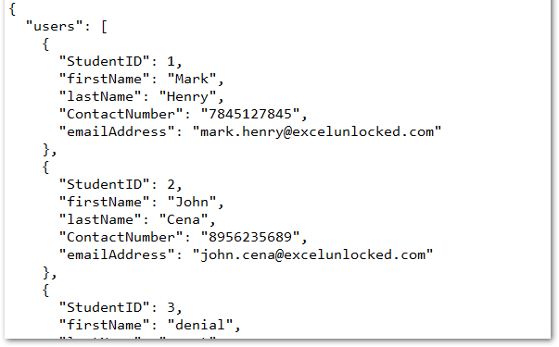
About JSON
JSON (JavaScript Object Notation) is a lightweight data-interchange format
Is alternative to XML or CDF (column delimited format)
In CBSO, JSON is used to return :
The reference data of a deposit
#/components/schemas/Reference
The content data of deposit (rubrics …)
#/components/schemas/AcountingData
Replaces TXT format used in old CBSO webservices

Slide 15
JSON representation for Reference data
#/components/schemas/Reference
Property | Type
ReferenceNumber | #ReferenceNumber
DepositDate | String
ExerciseDates | #Period
ModelType | String
DepositType | String
Language | String
Currency | String
EntrepriseNumber | String
EntrepriseName | String
Address | #Address
LegalForm | string
LegalSituation | string
GeneralAssemblyDate | string
ActivityCodes | array
AccountingDataURL | string
DataVersion | string
ImprovementDate | string
CorrectedData | string
FulfillLegalValidation | string
1 reference = 1 deposit (published) at NBB
The « reference » data type has the same structure for all webservices operations returning « references »
References are returned by Authentic & Improved :
Query : a list of references for a given legal entity
Batch : a list of references for a given date (in a zip)
Some fields may be empty depending on the operation
Key data
KBO data
Technical
data

Slide 16
JSON representation for AccountingData (1/2)
1 AccountingData = 1 deposit
« AccountingData » : data structure used for data extracted from XBRL or from PDF or after improvements (euro, corrections)
« AccountingData » has the same structure for all webservices operations returning data
Authentic/Improved :
Query : as JSON file for a given legal entity
Batch : a list of JSON files for a given date (in a zip)
#/components/schemas/AcountingData
Property | Type
ReferenceNumber | string
EnterpriseName | string
Address | #/AddressType
LegalForm | #/LegalFormType
JointComittees | #/JointCommitteeType
Rubrics | #/RubricType
Administrators | #/AdministatorsType
Shareholders | #/ShareholdersType
ParticipatingInterests | #/ParticipatingInterestsType
Report
data

Slide 17
JSON representation for AccountingData (2/2)
#/components/schemas/AcountingData
Property | Type
ReferenceNumber | string
EnterpriseName | string
Address | #/AddressType
LegalForm | #/LegalFormType
JointComittees | #/JointCommitteeType
Rubrics | #/RubricType
Administrators | #/AdministatorsType
Shareholders | #/ShareholdersType
ParticipatingInterests | #/ParticipatingInterestsType
#/components/schemas/RubricType
Property | Type
Code | string
Value | string
Period | string
DataType | string
TypeAmount | string
#/components/schemas/ParticipatingInterestsType
Property | Type
AccountDate | string
Currency | string
Entity | #/LegalPersonType
EntityLegalForm | string
Equity | string
NetResult | string
OtherEntityLegalForm | string
ParticipatingInterestsHeld | array of #/ParticipatingInterestHeldType

Slide 18
XBRL and PDF representations
XBRL and PDF are returned only by operations on « Authentic » webservice :
Query : the PDF file or the XBRL file is returned for a given reference of deposit
Batch : a list of PDF files or a list of XBRL files is returned for a given date (as a zip)
XBRL deposits, when the original deposit of the declarer is an XBRL :
The XBRL file returned by the webservice is the one filed by the declarer
The PDF file returned by the webservice is a PDF prepared by NBB based on the XBRL (idem Consult)
PDF deposits, when the original deposit of the declarer is a PDF :
No XBRL file is returned by the webservice
The PDF file returned by the webservice is the PDF of the declarer + cartouche (idem Consult)

Slide 19
Getting access to the webservices

Slide 20
Two steps procedure
Get abonnement with NBB
Get technical keys to use the webservices
Contractual
For the abonnee
Technical
For the user

Slide 21
Step 1 – Get subscription
Goal is to have list of clients with their contact data and list of active subscriptions
1 - Fill in request form and sign T&C (www.nbb.be)
2 - Encode new client and subscription in database (BackOffice App)
Request form
5 – Inform + CLIENT_ID
4 – Pay
3 – Send invoice
Subscriber
Contact Center
1st line
2nd line
5 – Inform Technical user + CLIENT_ID
Final procedure to decide by dept. DD
Invoice
5 – Send CLIENT_ID
Technical user
Not required for TEST env !

Slide 22
Step 2 – Get technical key
Subscriber and technical user may be different persons / companies
1 – Create login and request access for one or more products + CLIENT_ID
2 – Monitor incoming requests (no push !)
3 – Check CLIENT_ID
5 – Receive approval
2nd line
Technical user
BackOffice App
Developer Portal
4 – Approve requests
6 – Download token

Slide 23
Using the developer portal

Slide 24
Using the developer portal
Technical user :
Connect to https://developer.uat2.cbso.nbb.be/
Create account & check mails
Login
Request access for all products : authentic, query, improved
Check mails
If access not granted, contact: helpdesk.ba@nbb.be or
Technical user :
Download technical key

Slide 25
Webservices operations

Slide 26
Example via Postman (1/2)
https://www.postman.com/
Postman is an API platform for building and using APIs
Here, only used as “webservice client” to prepare, send and receive output of HTTP requests
Workspace = set of HTTP requests
HTTP request = one call to one Webservice operation with parameters
Alternatives exist = own software, SOAPUI, …

Slide 27
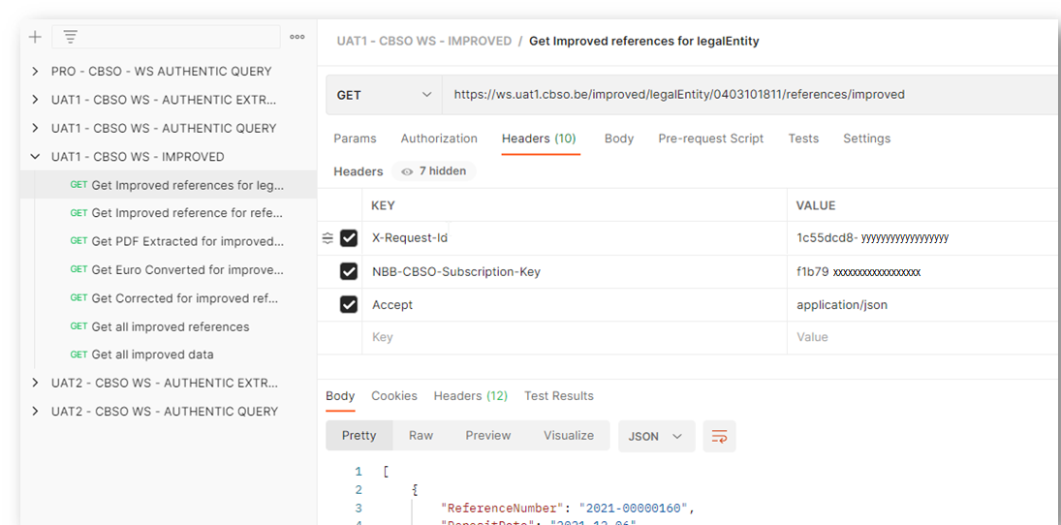
Example via Postman (2/2)
Workspace
REQUEST
REQUEST HEADERS
OUTPUT

Slide 28
Prepare a HTTP request
For executing an operation of the CBSO webservices you need to :
Define the URL : https://ws.uat1.cbso.be/authentic/legalEntity/0403101811/references
Provide HTTP headers (or query parameters)
The API key in “NBB-CBSO-Subscription-Key“ → obtained from the developer portal
The request ID in “X-Request-Id“ → client-side generated UUID (for traceability and debugging)
The media-type for the returned object in “Accept” → describe the desired format for the output
Server name
API name
Operation (here with parameter)
Other envs, see : Confluence

Slide 29
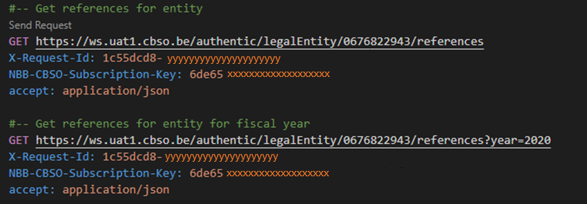
Exemples
accountingData

Slide 30
Overview of operations - Authentic
Product | API | Operations
Authentic Query | /authentic | /legalEntity/{legalEntityId}/references Accept = application/json → JSON file as output /deposit/{referenceNumber}/accountingData Accept = application/pdf → PDF file as output Accept = application/x.xbrl → XBRL file as output Accept = application/x.jsonxbrl → JSON file as output
Authentic Extract | /extract | /batch/{date}/references (Zip of JSON) Accept = application/x.zip+json → Zip of JSON /batch/{date}/accountingData Accept = application/x.zip+pdf → Zip of PDF Accept = application/x.zip+xbrl → Zip of XBRL Accept = application/x.zip+jsonxbrl → Zip of JSON

Slide 31
Overview of operations - Improved
Product | API | Operations
Improved data | /improved | /legalEntity/{legalEntityId}/references/improved Accept = application/json /deposit/{referenceNumber}/accountingData/improved/corrected Accept = application/x.jsonxbrl /deposit/{referenceNumber}/accountingData/improved/pdf_extracted Accept = application/x.jsonxbrl /deposit/{referenceNumber}/accountingData/improved/euro_converted Accept = application/x.jsonxbrl /batch/{date}/references/improved Accept = application/x.zip+jsonxbrl /batch/{date}/accountingData/improved Accept = application/x.zip+jsonxbrl

Slide 32
Any Questions ? info.ba@nbb.be subject: webservices

