Slide 1

The update of the Regulation on payments statistics
Tom VAN KEYMOLEN
François VAN TRIMPONT

Slide 2
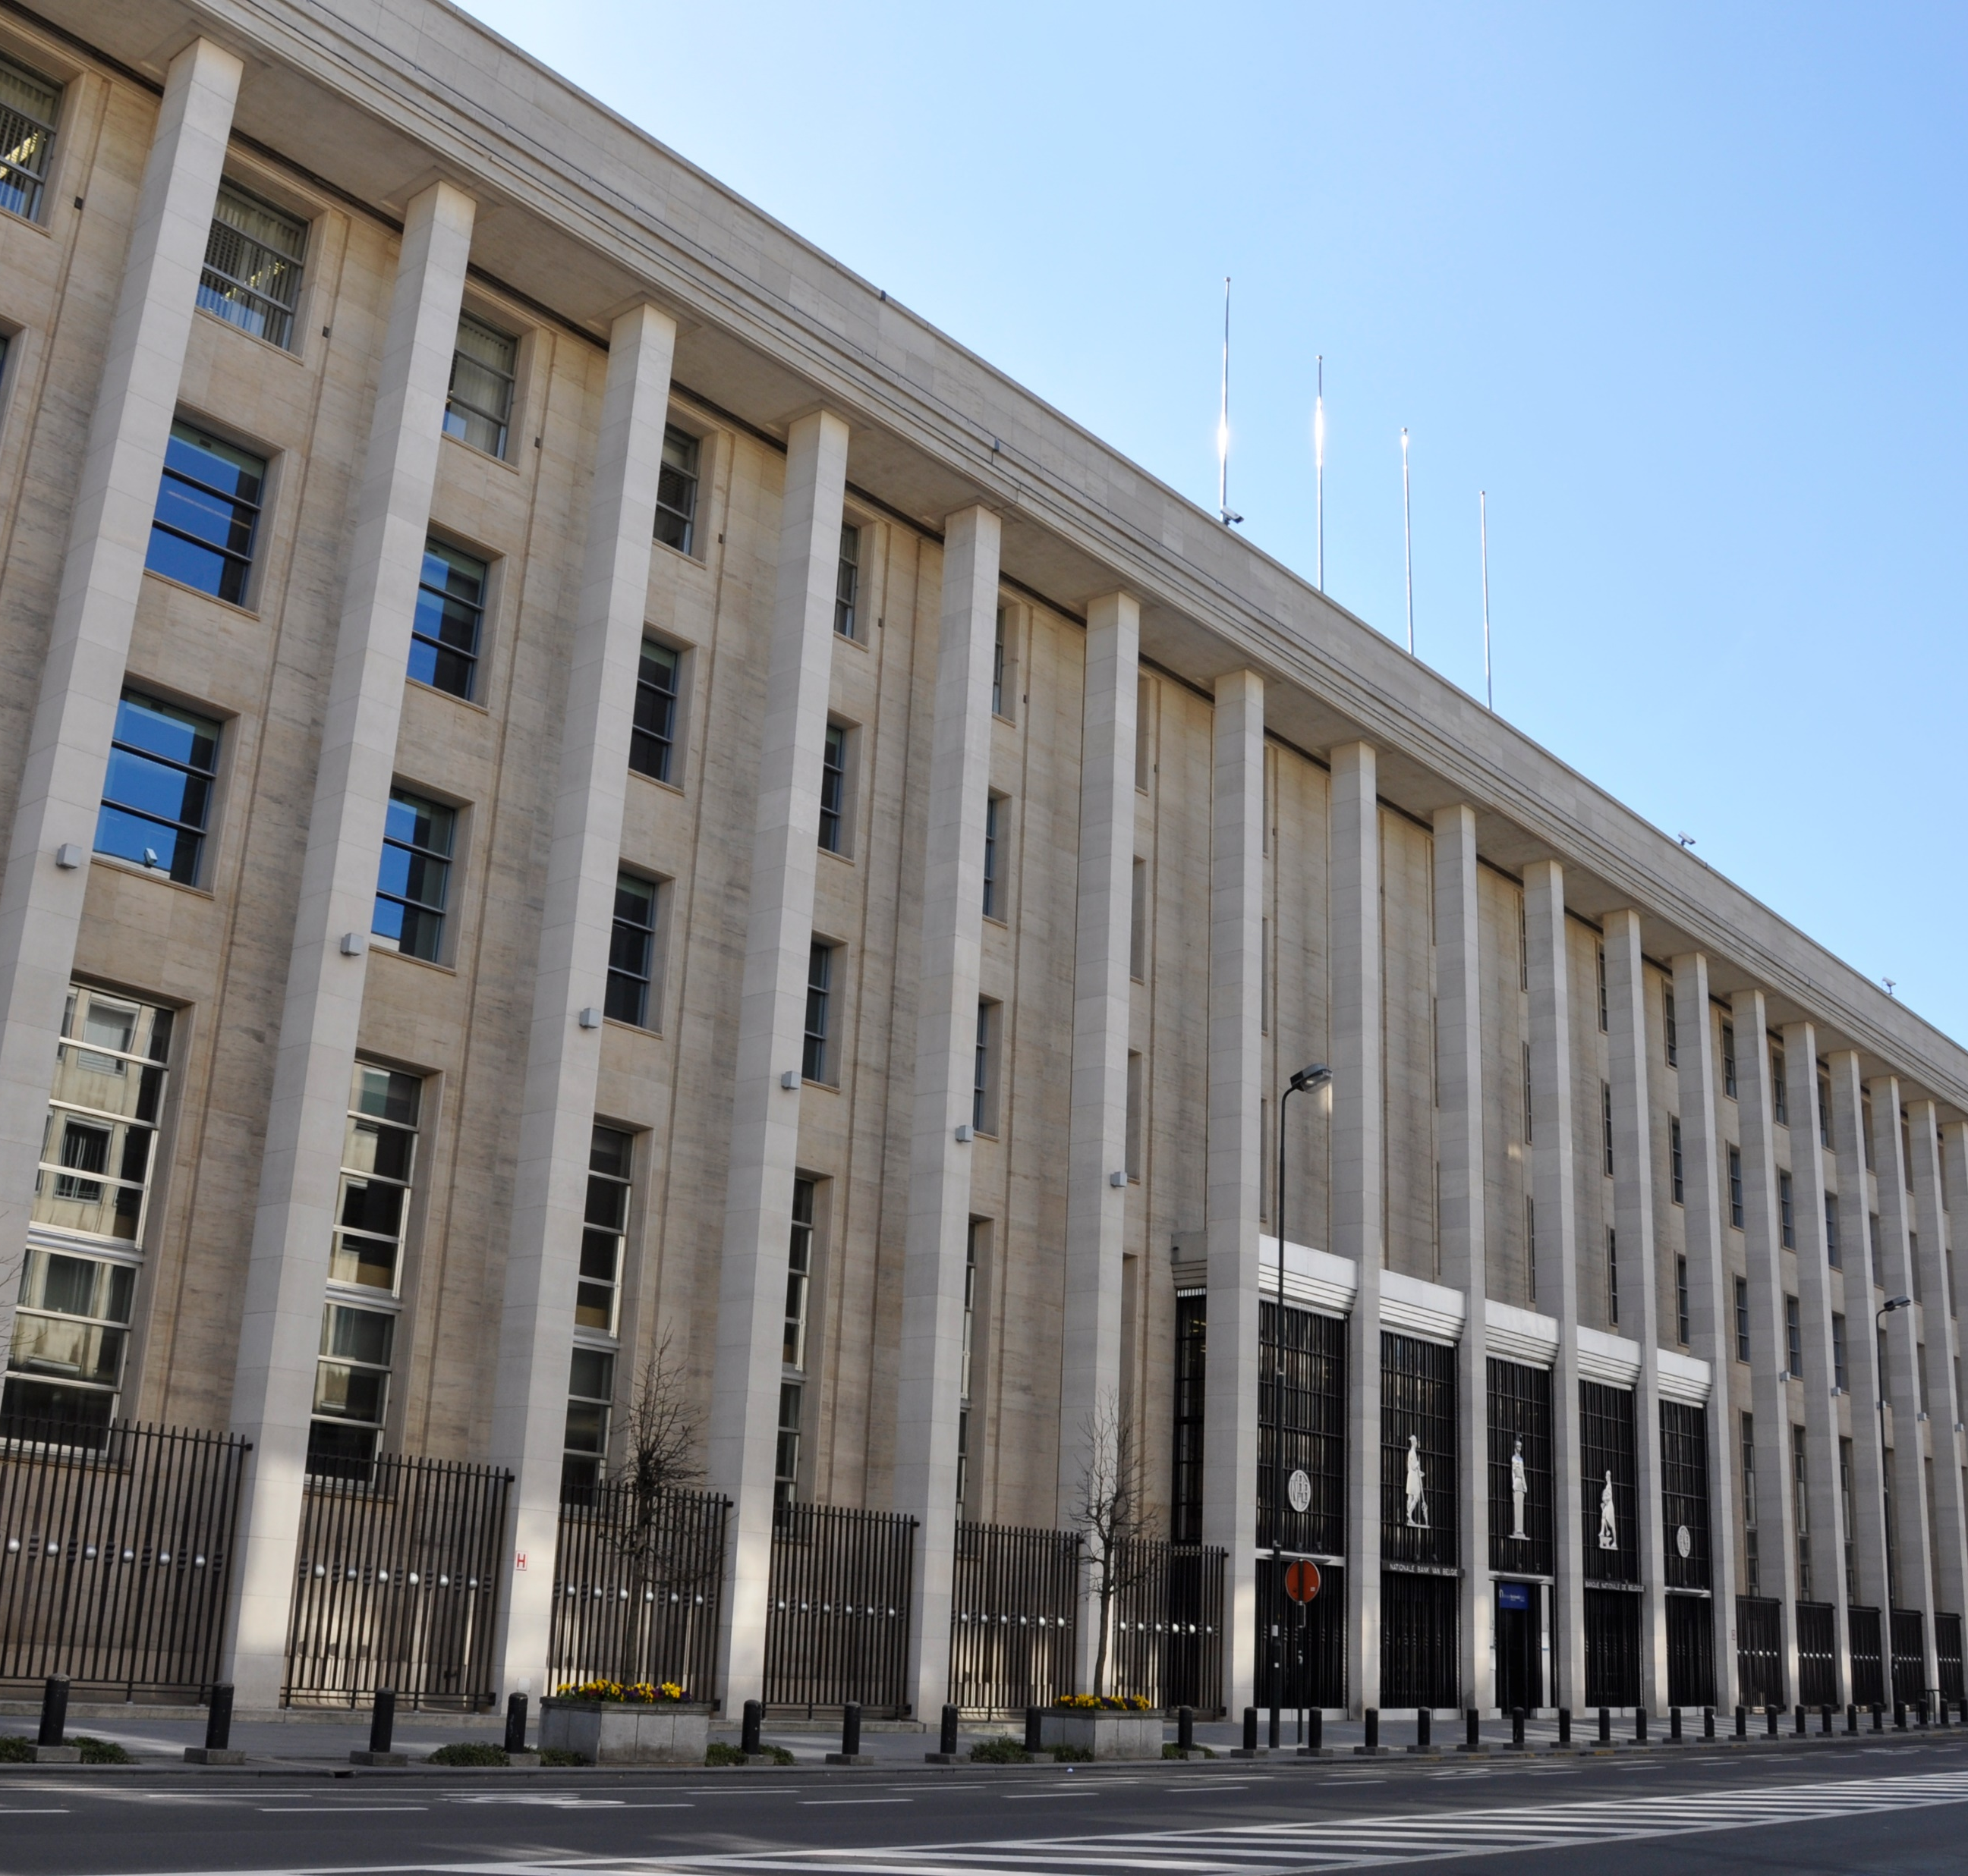
Key features of the amending Regulation
01
Payments Statistics - background
02
Key features of the amending Regulation
03
Implementation of the regulation
04
Derogation system
Hoofdstuk titel van
max. 2 regels

Slide 3
01
Payments Statistics - background
02
Key features of the amending Regulation
03
Implementation of the regulation
04
Derogation system
Hoofdstuk titel van
max. 2 regels

Slide 4
Payments statistics – background (1/4)
Payments statistics provide harmonised and comparable information on payments and payment systems in the EU
Compiled at annual frequency as of 2007
As from 2014 data collection based on ECB Regulation (ECB/2013/43) addressed to payment service providers and payment system operators resident in the euro area
  Complemented by Guideline addressed to euro area NCBs and a Recommendation addressed to the NCBs of non euro-area Member States
These statistics are used for
  analysis of policy questions and conduct of oversight of payment instruments and systems
  provision of information to general public and market participants

Slide 5
Payments statistics update – scope and user demands (2/4)
Retail payments are developing rapidly…
Mobile
wallets
Instant payments
Contactless card
Mobile P2P etc.

Slide 6
Payments statistics update – scope and user demands (3/4)
…legislation is catching up…
Second Payment Services Directive (PSD2)
  - New types of payment services in the market: payment initiation services and account information services
  - Strong customer authentication
  - Payment fraud reporting (needed to serve the ECB’s oversight function)
Interchange Fee Regulation (IFR)
  - New definition of cross-border card-based payment transactions
  - Different fees for credit and debit cards

Slide 7

Payments statistics update – scope and user demands (4/4)
…new user requirements arise
Monitoring cross-border trade
  - More frequent and detailed card data needed to monitor cross-border trade
  - Merchant category code (MCC) provides information of the business of the merchant
  - MCC reported quarterly when available
→ Need to update ECB Regulation in order to capture new developments and meet user needs

Slide 8
01
Payments Statistics - background
02
Key features of the amending Regulation
03
Implementation of the regulation
04
Derogation system
Hoofdstuk titel van
max. 2 regels

Slide 9
Key features of the amending Regulation
New initiation channels; changes in the payments systems
  (P2P) mobile payments, payment initiation services, instant payments
Fraud and related data
  Payments, fraudulent payments and authentication measures
  Overlap with EBA Guidelines necessitates a “single data flow”
Data for Balance of Payments purposes
  More detailed sectoral and geographic coverage
Enhanced frequency – quarterly and semi-annual reporting
Enhanced timeliness – 1-month for quarterly data, 3-months for semi-annual data

Slide 10
01
Payments Statistics - background
02
Key features of the amending Regulation
03
Implementation of the regulation
04
Derogation system
Hoofdstuk titel van
max. 2 regels

Slide 11
Tables split according to payment service (PST-3)
Table | Subject
Table 1 | Institutions offering payment services to non-MFIs (split by kind of PSP)
PCN | Number of cards issued by resident PSPs by card function and scheme
PTN | Number of terminals provided by resident PSPs by terminal type and function
PCT | Credit transfers
PDD | Direct debits
PEM | E-money payment transactions
PCP (issuers) | Card payments and cash withdrawals using cards
PCP (acquirers) | Card payments and cash withdrawals using cards
PIS | Payment initiation services
PAY | Other payments transactions
PLB | Losses due to fraud by liability bearer
PPT (issuers) | ATM, OTC and POS Terminal transactions
PPT (acquirers) | ATM, OTC and POS Terminal transactions
TRI | Quarterly reporting of payment transactions involving non-MFIs
Table | Subject
1 | Institutions offering payment services to non-monetary financial institutions (non-MFIs)
2 | Cards issued by resident PSPs
3 | Card accepting devices
4a, 5a | (Fraudulent) payment transactions involving non-MFIs
6 | Payment transactions per type of terminal involving non-MFIs
9 | Quarterly reporting of payment transactions involving non-MFIs
Guideline table A | Institutions offering payment services to non-MFIs
MCC from BOP reglement C

Slide 12
Payments Statistics Reporting (PST-3)
In OneGate, report ‘PST-3’
Can be filled in with XML or CSV files
  XML protocol, XML examples
  Excel reporting template
    Help generate CSVs
    Contains validation rules
Tables in OneGate Test will be available as of 01/07/2021

Slide 13
01
Payments Statistics - background
02
Key features of the amending Regulation
03
Implementation of the regulation
04
Derogation system
Hoofdstuk titel van
max. 2 regels

Slide 14
Derogation system
Partial derogation (Article 4 of ECB/2020/59)
  Less tables to report
  Same frequency but no quarterly data
Rule 1: for each payment services, 95% in value should be covered by institutions without a derogation
Rule 2: 95% of total number of clients of account information services should be covered by institutions without a derogation
Valid for 1 year and reassessed every year after compilation of the last year’s data
For new institutions (i.e. who have not reported yet for Payments Statistics), the use of a form is possible.

Slide 15
Tables split according to payment service (PST-3_DER)
Table | Subject
Table 1 | Institutions offering payment services to non-MFIs (split by kind of PSP)
PCN | Number of cards issued by resident PSPs by card function and scheme
PTN | Number of terminals provided by resident PSPs by terminal type and function
PCT | Credit transfers
PDD | Direct debits
PEM | E-money payment transactions
PCP (issuers) | Card payments and cash withdrawals using cards
PCP (acquirers) | Card payments and cash withdrawals using cards
PIS | Payment initiation services
PAY | Other payments transactions
PLB | Losses due to fraud by liability bearer
PPT (issuers) | ATM, OTC and POS Terminal transactions
PPT (acquirers) | ATM, OTC and POS Terminal transactions
TRI | Quarterly reporting of payment transactions involving non-MFIs
Table | Subject
1 | Institutions offering payment services to non-monetary financial institutions (non-MFIs)
2 | Cards issued by resident PSPs
3 | Card accepting devices
4b, 5b | (Fraudulent) payment transactions involving non-MFIs
6 | Payment transactions per type of terminal involving non-MFIs
9 | Quarterly reporting of payment transactions involving non-MFIs
Guideline table A | Institutions offering payment services to non-MFIs
Needed for rule 2

Slide 16
Payments Statistics Reporting (PST-3_DER)
In OneGate, report ‘PST-3_DER’
Can be filled in with XML or CSV files
  XML protocol
  Excel reporting template /!\ Different template (simplified)
    Help generate CSVs
    Contains validation rules
List of institutions with a derogation will be communicated in May 2021. The Excel reporting template will be published at the same time.
Tables in OneGate Test will be available as of 01/07/2021

Slide 17
Questions?
Payments.statistics@nbb.be
A FAQ will be published on our website with answers to your questions

